Slide 1

FACIAL ATTENDEE
Easiness in Taking Attendance

Slide 2
Abstract
Tedious process of attendance marking by manually calling out student
Conventional methods apart from being time-consuming are also prone to errors
Need for fast and reliable attendance marking system
An automated facial based attendance system namely Facial Attendee
Completely based on deep learning neural network and implemented using Tensorflow framework
Real-time face recognition is done using FaceNet

Slide 3
Project Motivation
Attendance is known to be a key factor in students’ academic performance
Almost 80% of the educational institutes in Karachi follow the manual procedure of maintaining students’ attendance which is both time-consuming and prone to errors.
Other procedures such as thumb verification or card validation also involve queuing delay.

Slide 4
Project Definition
Taking manual attendance is a hard process, this project aims to provide institutes to mark the attendance of their students a lot more conveniently and efficiently using Facial Recognition Technique.

Slide 5
Project Scope
The project is targeted towards academic institutions providing a web portal for with all courses information along with respective attendance. The project also incorporates a mobile application for the students to view their attendance information course wise.

Slide 6
Literature Review
Personal Identification and Description by Francis Galton
Hybrid Deep Learning for Face Verification by Sun Yi Wang, Xiaogang Tang & Xiaoou
Face Recognition: Features versus Templates by R. Brunelli and T. Poggio
Reference Face Graph for Face Recognition by Kafai, Mehran & An, Le & Bhanu, Bir.
Research about Human Face Recognition Technology by Chenggang Zhen and Yingmei Su
A Discriminative Feature Learning Approach for Deep Face Recognition by Wen, Yandong & Zhang, Kaipeng & Li, Zhifeng & Qiao, Yu.

Slide 7


MySQL
HTML CSS
Tensor Flow
Used as a database to store all information except the images of user.
Used as a front-end language for web portal (Teacher Portal)
Used to train the model (making FaceNet) and Predict the Face to mark attendance.
TECHNOLOGY USED
JAVA
Python Django
Miscellaneous
Used to write the APIs in order to provide a Django server that connects the database to the mobile app and website
Used to create and deploy the Naive Android application for the Students.
Sketch
ERDPlus
GitHub

Slide 8
Reusable Components
Django - Python Framework
Sketch - UI Prototyping
Bootstrap Components
OpenCV
Tensorflow
Volley - JAVA

Slide 9
Functional Requirements of Project
The functional requirement includes following:
Main features of Web App
Admin Panel
Teacher Panel
Main features of Mobile App
Student Panel

Slide 10
Main Features of the Admin Panel
Add, Delete, Update and View
Courses
Teachers
Students
Assign Courses to Teachers
Enroll Student into different Courses with Specific Teacher

Slide 11
Main Features of the Teacher Panel
Add Attendance Sheet for Specific Date and Course
View Attendance Sheets
View Summary of Attendance Sheets
Confirm Attendance Sheet
Respond to Reported Attendance

Slide 12
Main Features of the Student Panel
View the Attendance Record
Report Attendance in case of Ambiguity

Slide 13
NonFunctional Requirements of Project
The performance characteristics of the system that are required by the business are that the:
Performance - less time required
Safety - the code should maintain different Version so can easily roll back
Security - the data and images should be saved in secured manner
Accuracy - the recognition of Face should be as accurate as possible
Easy to use for each and every user
the software is reliable
very less likely to crash, shut down, or data leak

Slide 14
Potential Users of Project
Mainly includes the Educational Institutes of Country, but it can be modified such that it can be used in Industrial and Service Sector too.

Slide 15
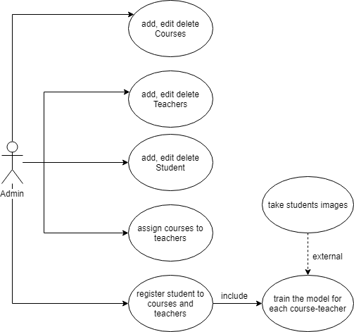
Use Case Diagrams
ADMIN
STUDENT
TEACHER

Slide 16
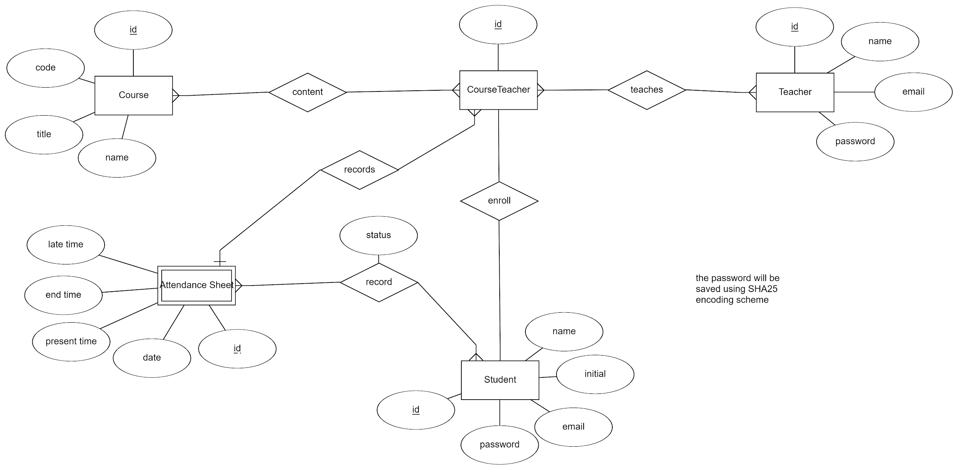
Database ERD Diagram

Slide 17
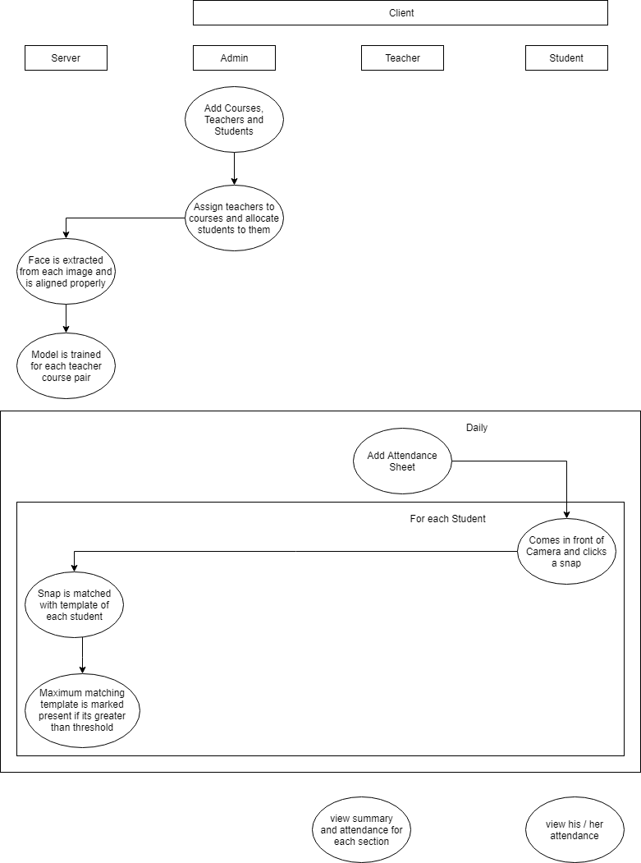
Architecture Block Diagram

Slide 18
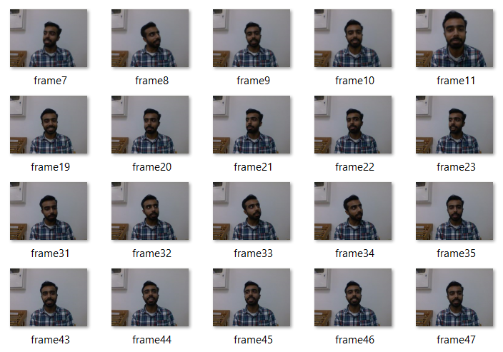
Data Collection Image Dataset
50 pictures of each student from 20 student was taken and stored in files with students id (the unique id) as the title. The key is to take images with a number of variations i.e. different angles, different emotions, with or without glasses etc.

Slide 19
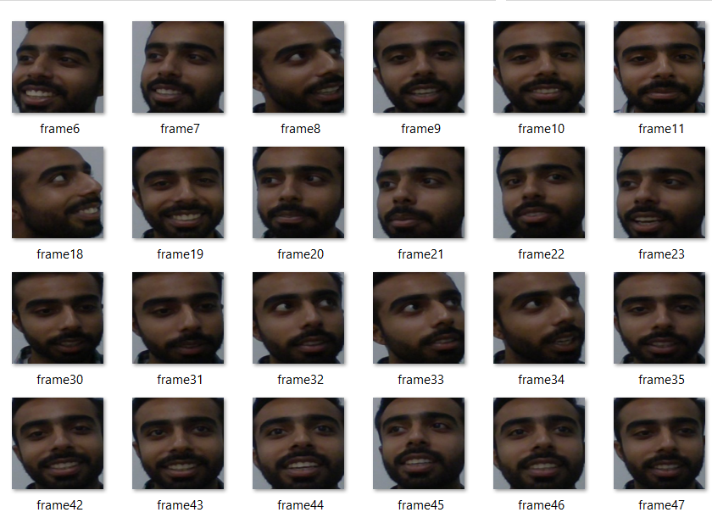
Preprocessing Extracting Faces
The face is extracted from each image set and is arranged in proper folder with Student ID title.
This is given as input for Data Model Training.

Slide 20
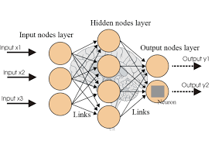
Model Training - CNN
This phase of implementation included training the model with the predefined model of OpenCV.
Convolutional Neural Network strategy was implemented using TensorFlow.

Slide 21
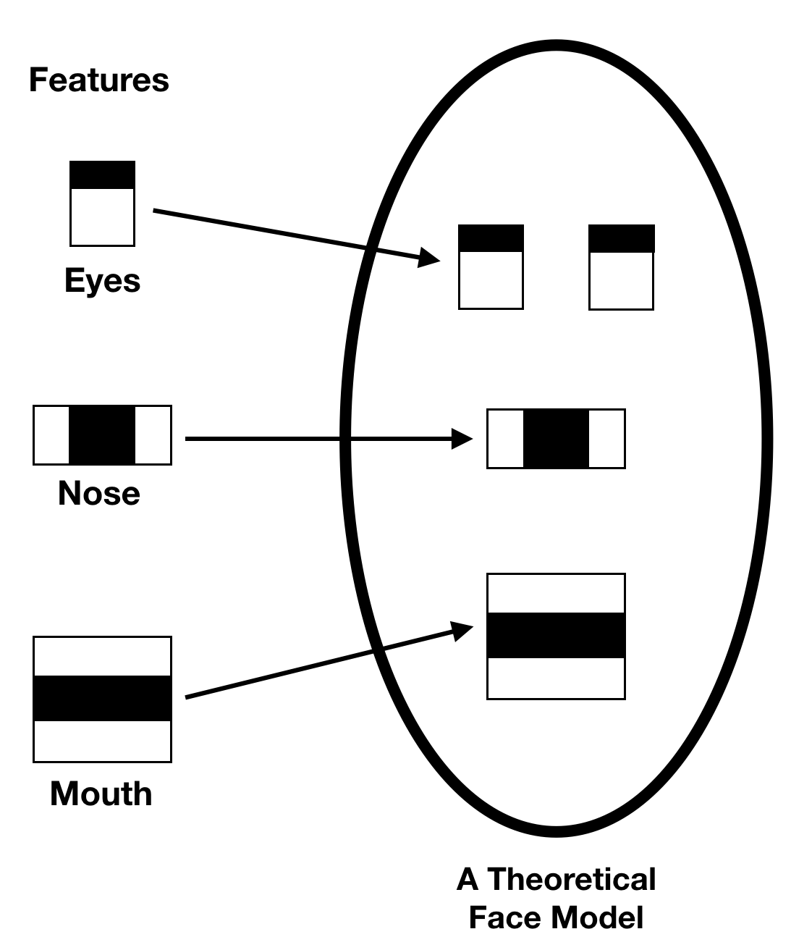
Face Detection - FaceNet
The implementation of face detection is done using Haar Cascade classifier using the Viola-Jones method of image detection.
This method uses small number of important features from a large set.

Slide 22
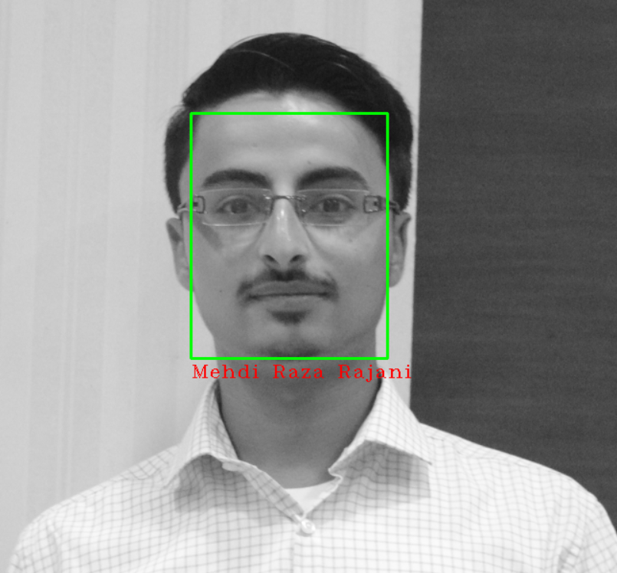
Face Recognition - CNN
After the image is detected by the image detector Face recognizer uses those images to apply the algorithm and recognize the face based on the trained data model.

Slide 23
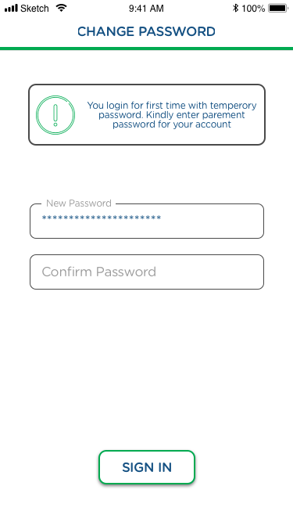
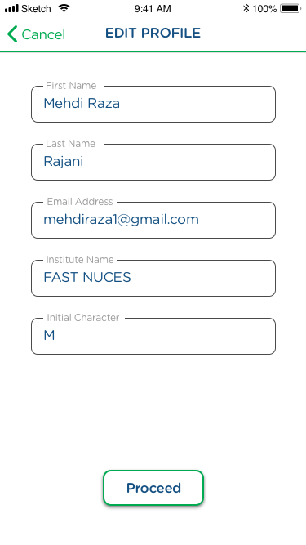
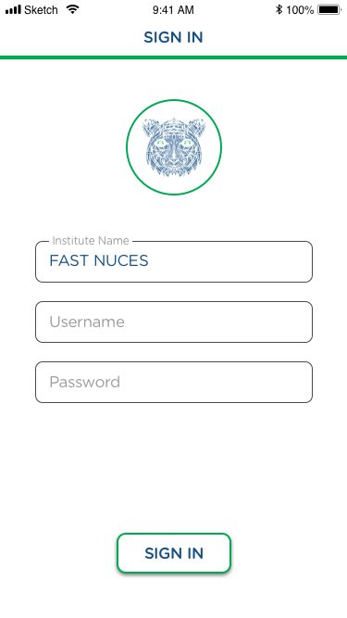
Mobile Prototype Designs

Slide 24
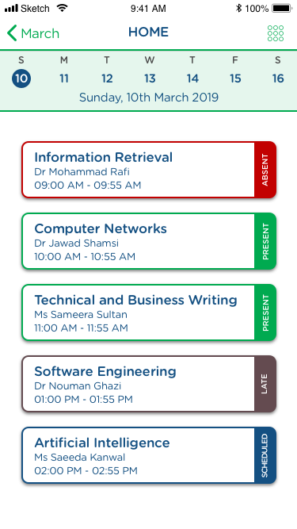
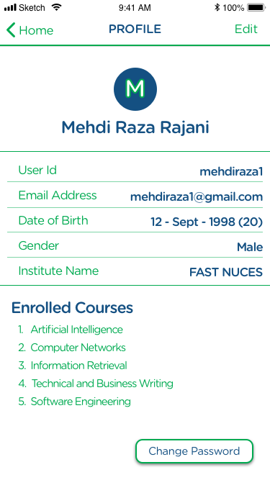
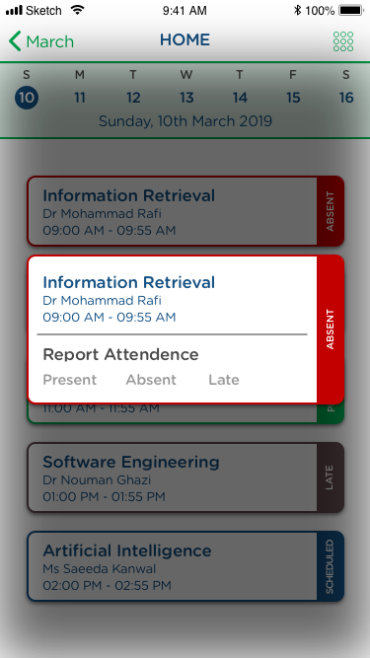
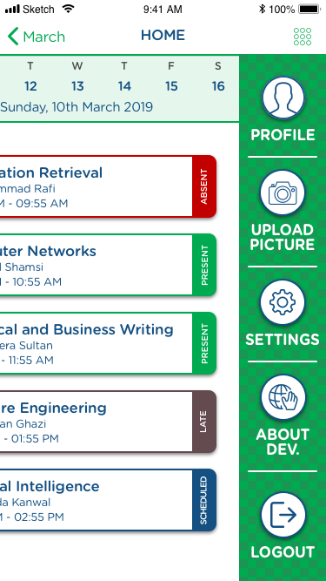
Mobile Prototype Designs

Slide 25
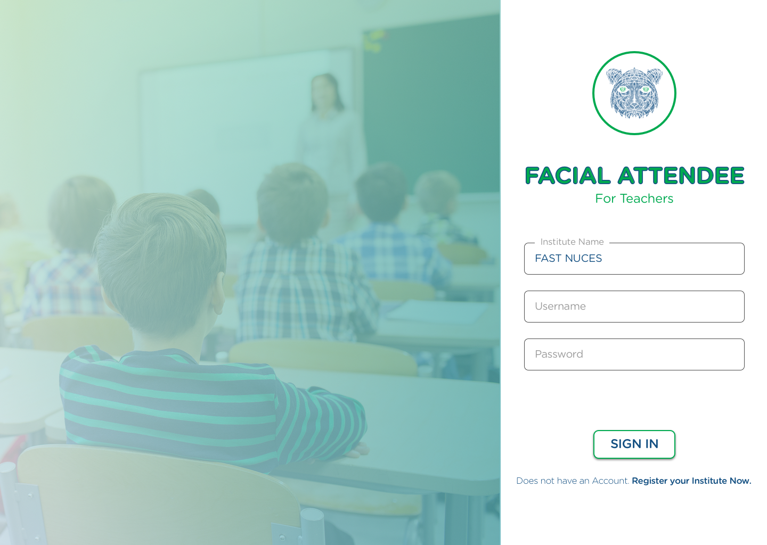
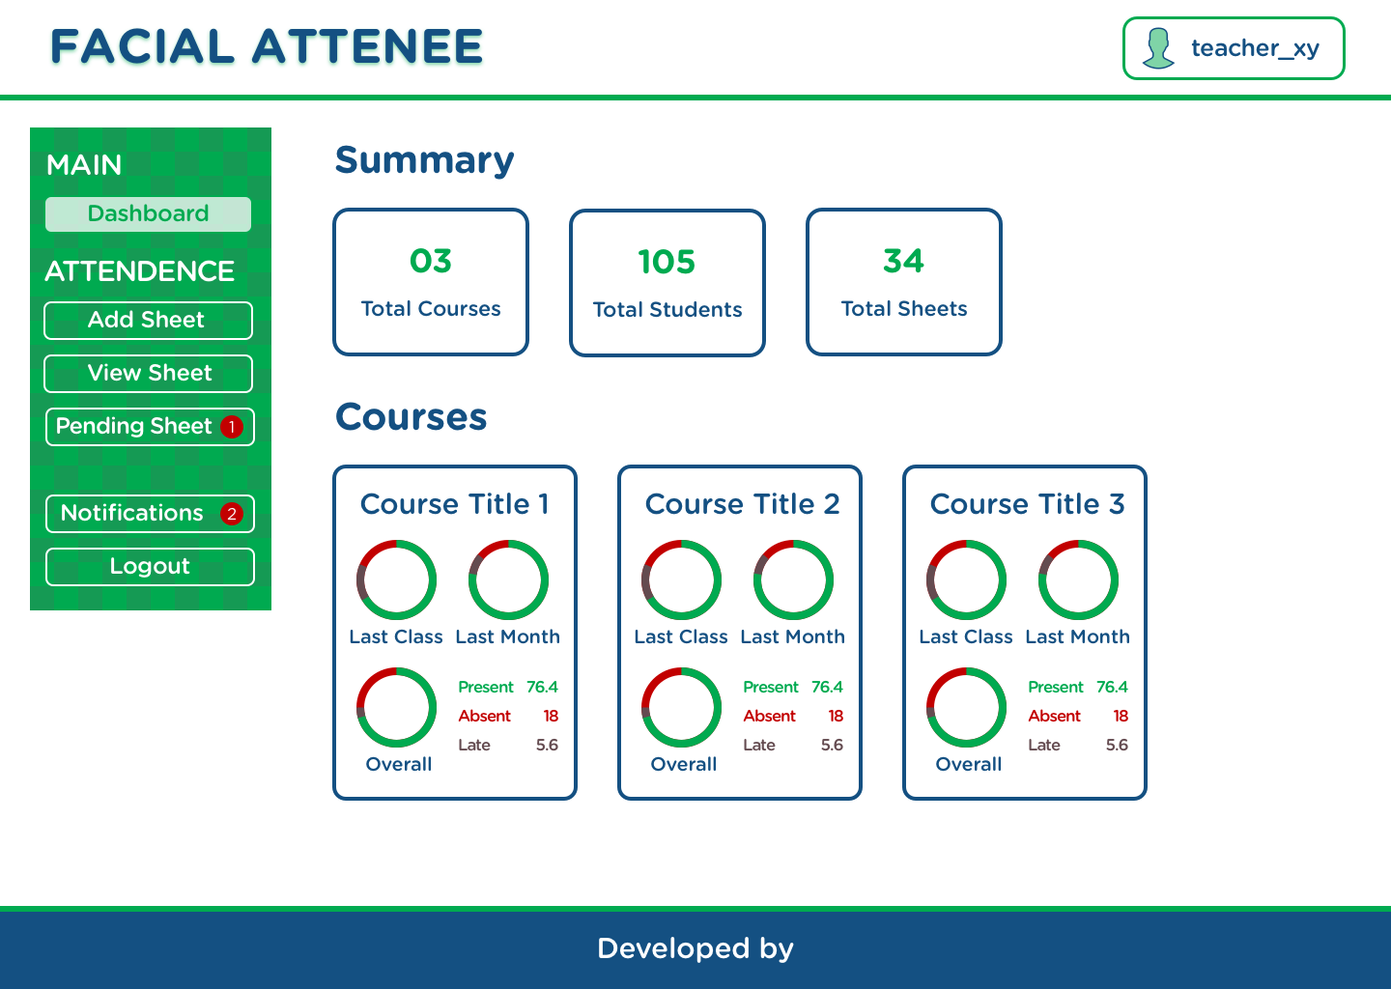
Web Prototype Designs

Slide 26
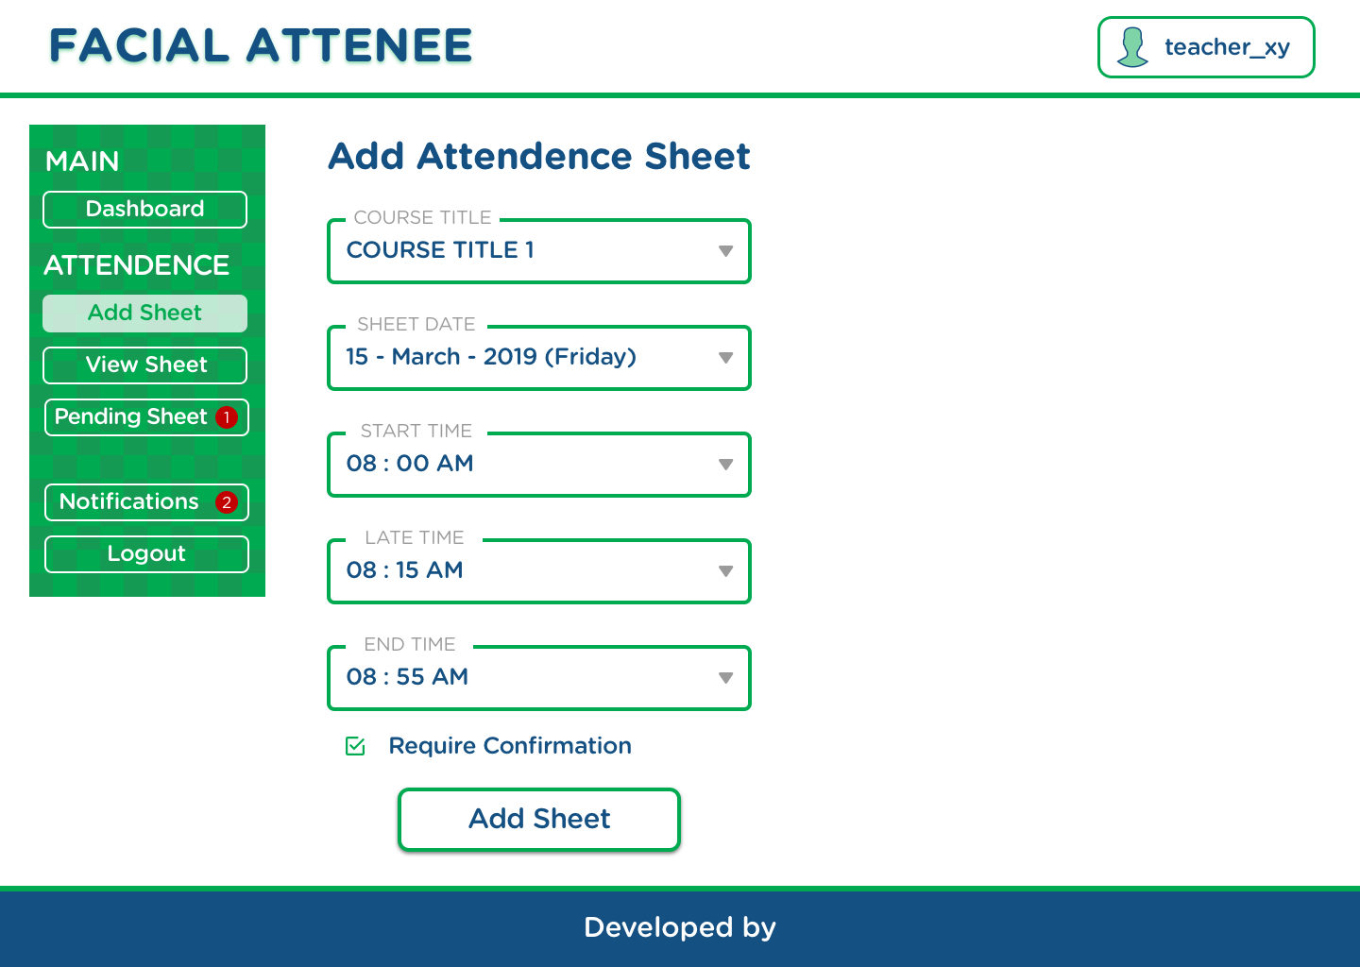
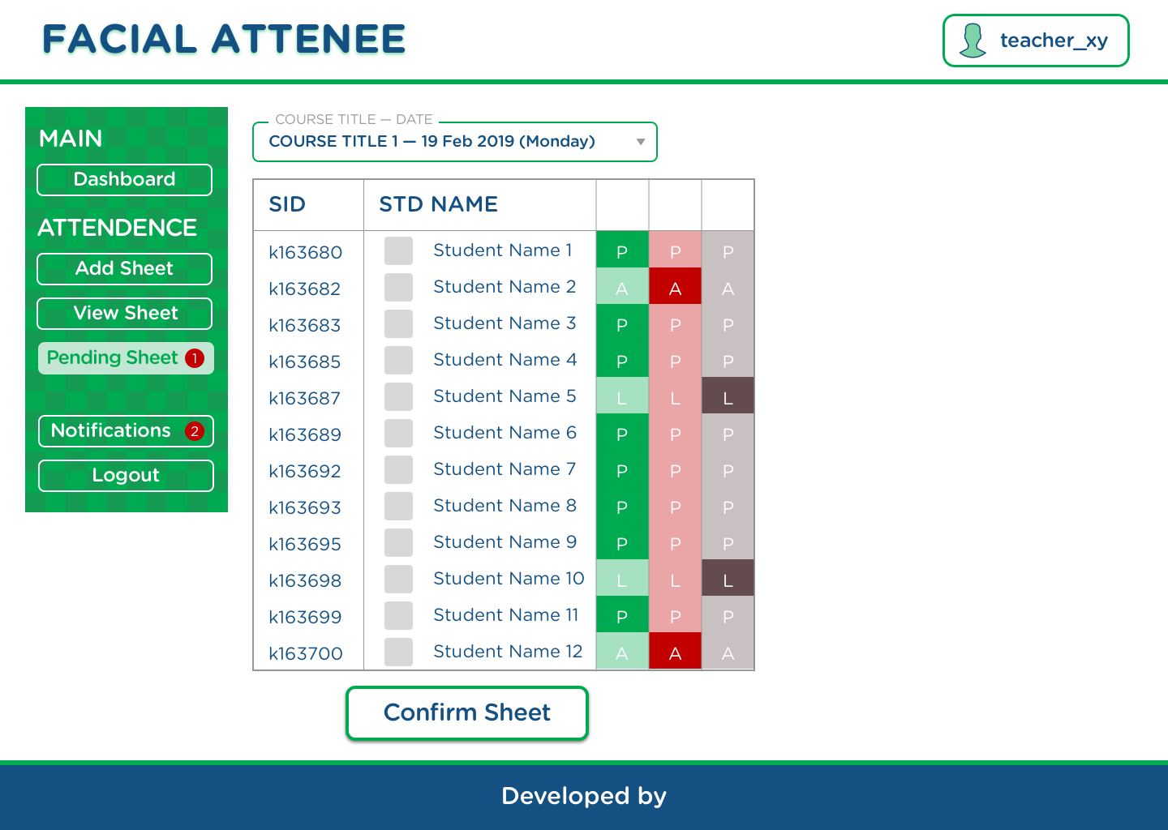
Web Prototype Designs

Slide 27
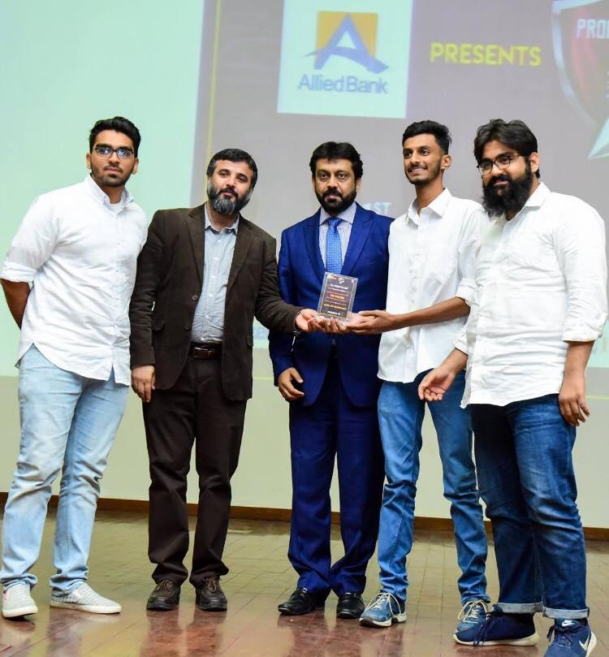
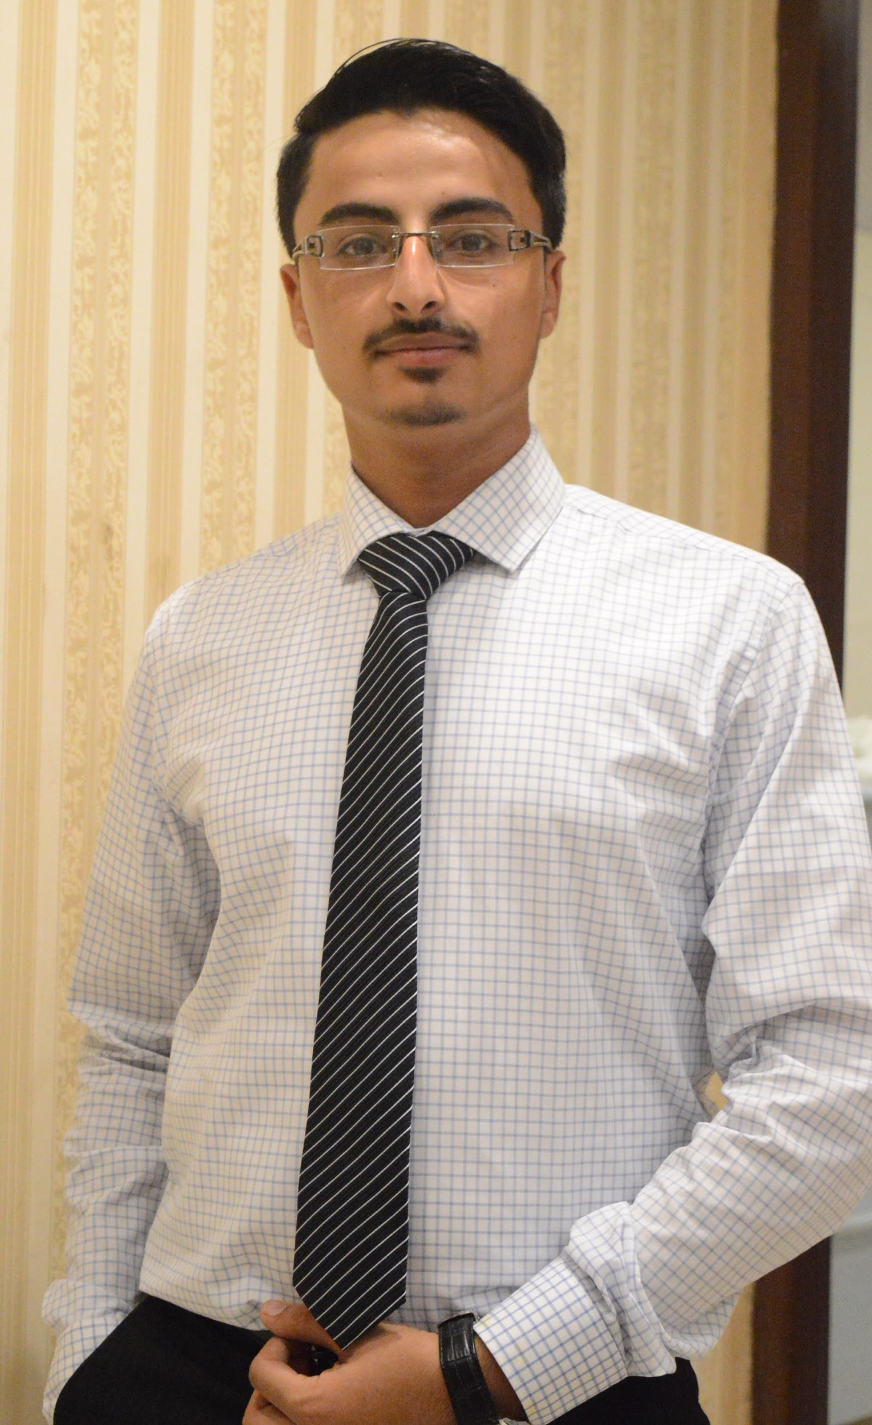
Muhammad Raza Vasnani
Mehdi Raza Rajani
Roll Number: k163890
Email Address: k163890@nu.edu.pk
GitHub: muhammadraza77
LinkedIn:
Roll Number: k163904
Email Address: k163904@nu.edu.pk
GitHub: Rajani1998
LinkedIn: mehdiraza572
DEVELOPERS
Muhammad Ammar Rizwan
Tahir Raza Hemani
Roll Number: k163862
Email Address: k163862@nu.edu.pk
GitHub:
LinkedIn:
Roll Number: k163905
Email Address: k163905@nu.edu.pk
GitHub: tahirrazahemani
LinkedIn:

Slide 28
FACIAL ATTENDEE
The End
THANK YOU

